Slide 1
SOCIAL MEDIA AND THE WORKPLACE
Trusted Advisors
A Presentation to the Annual Conference of the Professional Engineers and Geoscientists of BC
October 25 – 27, 2012 Victoria Conference Centre Victoria, BC
Carman J. Overholt, Q.C. OVERHOLT LAW Barristers & Solicitors
600 – 889 West Pender Street
Vancouver, BC V6C 3B2
Direct: (604) 676-4196
carman@overholtlawyers.com

Slide 2
Introduction
The media reports daily on a wide range of subjects demonstrating the way in which technology has fundamentally changed our lives and the workplace
Workplace technology usage has been the subject of a wide range of legal disputes and claims in the last decade
The Courts have recognized how technology creates an opportunity for “limitless defamation”
Mr. Justice Blair of the Ontario Court of Appeal in Barrick Gold Corporation v. Jorge Lopehandia and Chile Mineral Fields Canada Ltd.(2004) held:
OVERHOLT LAW
Trusted Advisors

Slide 3
The Law cont …
“The Internet represents a communications revolution. It makes instantaneous global communication available cheaply to anyone with a computer and an Internet connection. It enables individuals, institutions, and companies to communicate with a potentially vast global audience. It is a medium which does not respect geographical boundaries. Concomitant with the utopian possibility of creating virtual communities, enabling aspects of identity to be explored, and heralding a new and global age of free speech and democracy, the internet is also potentially a medium of virtually limitless international defamation.”
Trusted Advisors

Slide 4
Introduction
Trusted Advisors
How should Employers regulate the use of social media in the workplace?
How does the law balance rights to organize the workplace and union membership/representation with the protection of the employer’s business interests and property in social media communications?
There have already been a significant number of disputes that have occurred to date in connection with workplace technology and the use of social media by employees
How have labour boards, arbitrators, human rights tribunals and the courts addressed the subject of misuse of social media?

Slide 5
Introduction (cont’d)
Trusted Advisors
What developments in the law can we expect in the future?
What will be the impact of social media on the workplace?

Slide 6
1 Social Media Overview Social Media: Facebook
Biographical profile: personal details, sometimes including place of work
Network driven: people linked together by membership in organizations
Content can be seen by those in the network, and potentially, anyone browsing the site if specific privacy settings are not chosen by the user
Trusted Advisors

Slide 7
Why does Facebook matter?
Trusted Advisors
More than 500 million active users
Canada is 6th in Facebook usage in the World
(see: http://www.nickburcher.com/2010/09/facebook-usage-statistics-by-country.html)

Slide 8
Why does Facebook matter?
Fastest growing demographic: 25 years old and older
85 percent market share of 4-year U.S. universities
Average time per day on Facebook 23.7 minutes
Trusted Advisors

Slide 9
Blogs & Social Networking
Blogging:
A “blog” is short for a web log. It is an online personal journal established and frequently updated by an individual
Typically fully searchable
Trusted Advisors

Slide 10
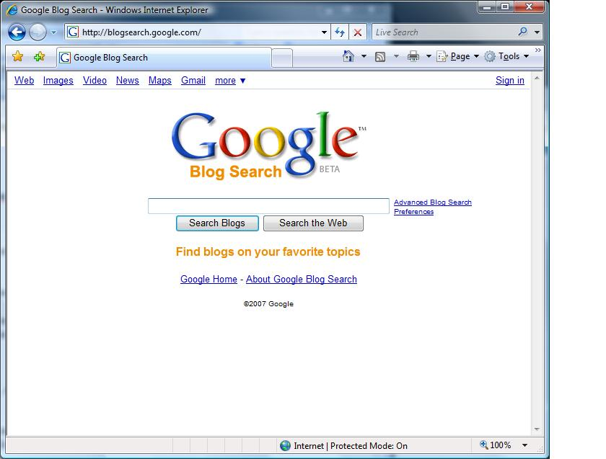
Searching Blogs
Trusted Advisors

Slide 11
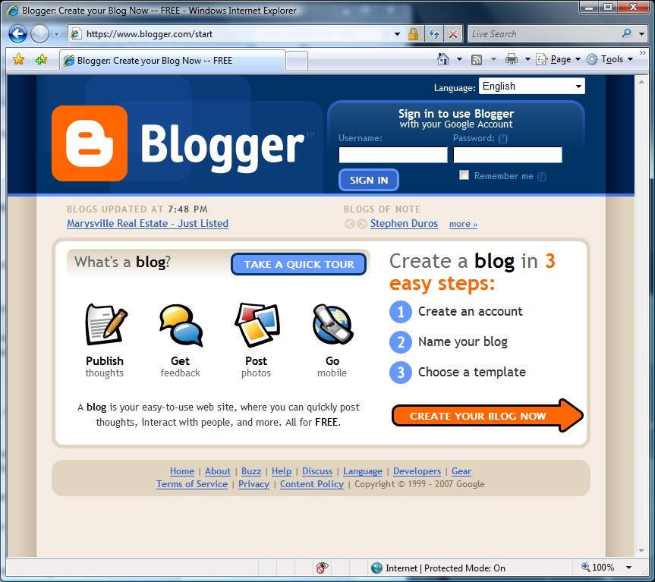
Searching Blogs
Trusted Advisors

Slide 12
Twitter
Instant updates
Real time information network
Information sharing
Gather real-time market intelligence and feedback
Business can engage an audience
Trusted Advisors

Slide 13
2 Organizing Campaigns Social Media: The right to organize and freedom of speech
"Subject to the regulations, a person has the freedom to express his or her views on any matter, including matters relating to an employer, a trade union or representation of employees by a trade union, provided that the person does not use intimidation or coercion."
Labour Relations Code, RSBC 1996, c. 244, s. 8.
Trusted Advisors

Slide 14
Social Media:
The right to organize and freedom of speech
Trusted Advisors
"A trade union or other person may, at any time and in a manner that does not consitute picketing as defined in this Code, communicate information to a person, or publicly express sympathy or support for a person, as to matters or things affecting or relating to terms or conditions of employment or work done or to be done by that person."
Labour Relations Code, RSBC 1996, c. 244, s. 64

Slide 15
Social Media:
The right to organize and freedom
of speech
Trusted Advisors
"…[L]abour speech engages core values of freedom of expression, and is fundamental not only to the identity and self-worth of individual workers and the strength of their collective efforts, but also to the functioning of a democratic society. Restrictions on any form of expression, and particularly expression of this gravity, should not be lightly countenanced."
RWDSU, Local 558 v. Pepsi-Cola Ltd., [2002] 1 SCR 156, at ¶69, per McLachlin C.J. and LeBel J.

Slide 16
Social Media:
The right to organize and freedom
of speech
Social network unionism: a shift towards a peer-to-peer, transnational, common, hyperempowered labour class movement
Twitter
Google + circles; iGoogle
Facebook’s Smartlists
UnionBook
Trusted Advisors

Slide 17
Social Media:
The right to organize and freedom of speech
The trade union movement is using "social network unionism" as a tool to organize workers globally
Trusted Advisors

Slide 18
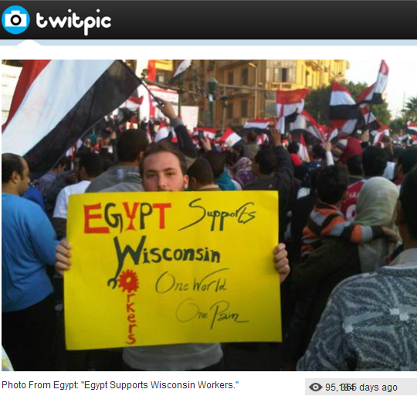
Social Media:
The right to organize and freedom
of speech
Trusted Advisors

Slide 19
Social Media:
The right to organize and freedom
of speech
The BC LRB questioned how access to social media and the internet should influence its assessment of whether it is practically possible to decertify the whole unit.
Re Certain Employees of BCAA, BCLRB B106/2011, at ¶43-48.
Trusted Advisors

Slide 20
Social Media:
The right to organize and freedom
of speech
Held: The internet, social media and smart-phones erode barriers to employee participation in workplace democracy, but do not replace the effectiveness of one to one communcation.
Trusted Advisors
Re Certain Employees of BCAA, BCLRB B106/2011, at ¶43-48 and BCLRB B184/2011

Slide 21
U.S. National Labor Relations Board Settlement
(February 8, 2011)
Dismissal of Connecticut ambulance service employee for posting negative comments about a supervisor on her Facebook page
Overly broad rules in Employee Handbook regarding blogging, internet posting and communications between employees
The Employer agreed to revise the Handbook rules to ensure that they did not prevent employees from discussing their wages, hours and working conditions with co-workers and others while not at work
Dismissal of employee was addressed through a separate “PRIVATE” agreement
Trusted Advisors

Slide 22
Schulte (NLRB - 2011)
Employee alleged that he was dismissed because of discussions of employer’s overtime policy
Employer alleged that his dismissal was due to his reference of job title as “fucktard” on his LinkedIn account
Trusted Advisors

Slide 23
Hispanics United
(NLRB - 2011)
NLRB found that a Facebook discussion between employees was activity for the purpose of collective bargaining and entitled to protection
Trusted Advisors

Slide 24
The Rock Wood Fire Pizza & Spirits (NLRB - 2011)
Trusted Advisors
Employee dismissed for Facebook comments
Employee claimed to be a Whistleblower in reporting the misconduct of a co-worker
The Board found that the comments were not protected because she was not a Whistleblower and the comments had a limited connection to the terms and conditions of her employment
Comments were not directed to other employees so it was not a concerted activity nor were they about the terms of employment

Slide 25
Wal-Mart (NLRB – 2011)
Individual gripe to other employees did not constitute a protected activity
The Board found that postings were not an attempt to initiate the group action of employees
Discipline of employee was not unlawful
Trusted Advisors

Slide 26
Social Media:
The right to organize and freedom of speech
UFCW and IPC CA decision varied QB decision
In April 2012, the ABCA allowed the appeal in part and held that the relevant provisions of the Act were not invalid, but the application of these providsion to the activities of the union was unconstitutional
UFCW, Local 401 v. Information & Privacy Commissioner, 2011 ABQB 415
Argued in ABCA Jan. 13, 2012, decision pending
Trusted Advisors

Slide 27
Practical Issues for Unions
Trusted Advisors
“Cyberunions” is a UK website (http://cyberunion.org) developed by union activist to educate the labour movement on the cultural implications of new technology and how to utilize this for organizing campaigns and communicating to members
Resources include the report “What unions can learn from Facebook” and the presentation “Trade Unions, Web 2.0 and Social Media”

Slide 28
3 Unfair Labour Practices
Trusted Advisors
Viking Air Limited v. National Automobile, Aerospeace, Transportation and General Workers Union (CAW-Canada, Local 114), BCLRB B18 2012
Union complaint that Employer breached section 6(1) of the Labour Relations Code by refusing to provide the Union with email addresses in its possession for employees in the bargaining unit

Slide 29
Unfair Labour Practices
(cont’d)
Board relied upon Port Transport Inc. (BCLRB No.50/2011) and P. Sun’s Enterprises Ltd. (BCLRB No.388/2003)
Requirement to provide information that may be readily provided to fulfill statutory obligations
Board dismissed the complaint
The Union should ask members for that information independently
Trusted Advisors

Slide 30
4 Free Speech and
Defamation
The Test
Words that lessen reputation in the eyes of a reasonable person
Words were published and referenced the Plaintiff
Malice intended
Trusted Advisors

Slide 31
The Defences
Truth/justification
Privileged
Fair comment – public interest
Trusted Advisors

Slide 32
The Case Law:
Grant v. Torstar (2009)
“Responsible Communication” defence. The communication must (a) be in the public interest;
and (b) be responsible
Cookes v. Newton (2011)
Hyperlinks
Trusted Advisors

Slide 33
Teamsters Local Union No. 987 v. O’Hallaran (BCCA)
Context of communications must be considered
What was dominant motive?
Trusted Advisors

Slide 34
Seafarers v. ILWU
Raid
Statements made by defendant union president at a meeting with bargaining unit members
Qualified privilege was found to be a defence that was available
May be subject to challenge depending upon evidence of malice
Trusted Advisors

Slide 35
5 Expectations of Privacy
Privacy Implications
Personal Information Protection Act, S.B.C. 2003, c.63 - collection, use and disclosure of personal information of both potential and current employees
The Office of the Information and Privacy Commissioner for British Columbia has established a four part test on employee monitoring:
Is the monitoring demonstrably necessary to meet a specific need?
Is the monitoring likely to be effective to meet that need?
Is the loss of privacy proportional to the benefit gained?
Is there a less privacy intrusive way of achieving the same end?
New Guidelines have been released by the BC Privacy Commissioner on Background checks
Trusted Advisors

Slide 36
R. v. Cole, 2011 ONCA 218
Trusted Advisors
Teacher issued a laptop by his employer and permitted to use it for personal use and to take it home on weekends and vacations
Teacher had inappropriate data about a student which was found by a technician of the employer performing a scan of the laptop
Teacher charged by police

Slide 37
R. v. Cole, 2011 ONCA 218 (contd.)
Did the Teacher have a reasonable expectation of privacy in the use of the laptop that was owned by the school?
The Ontario Court of Appeal said yes. Lack of a clear and unambiguous policy to monitor, search or police the use of the laptop was one of the factors leading to an expectation of privacy by the user
The warrantless search of the laptop by the police was contrary to the Charter
Trusted Advisors

Slide 38
R. v. Cole, 2011 ONCA 218 (contd.)
Lessons from R. v. Cole:
Critical to have a well-drafted technology and social media policy to address the expectation of privacy by employees
The fact the device is owned by the employer no longer means they have an absolute right to access the data without the consent of the user and without respecting privacy laws
Leave has been granted for an appeal to the Supreme Court of Canada
Trusted Advisors

Slide 39
Expectation of Privacy
The tort of invasion of privacy
Jones v. Tsige – (Ontario Court of Appeal – January 18, 2012)
Future developments in the law
Claim dismissed by the Motions Judge on the basis that the law did not recognize a tort of breach of privacy
Trusted Advisors

Slide 40
Expectation of Privacy (con’t)
Respondent disciplined by her Employer
In the civil proceeding, the Appellant claimed damages of $70,000 for breach of fiduciary duty and invasion of privacy and $20,000 for punitive damages
The claim was dismissed by the Motions Judge and costs of $35,000 were awarded to the Respondent on the basis that Appellant was aggressive in the litigation and ought to have accepted reasonable offers of settlement
Trusted Advisors

Slide 41
Expectation of Privacy (con’t)
Ontario Court of Appeal was asked to consider the following question:
“Does Ontario law recognize a right to bring a civil action
for damages for the invasion of personal privacy?”
Appellant discovered that Respondent had “surreptitiously” looked at her banking records
Parties both worked for the same employer, a Bank
The Respondent had formed a common law relationship with the Appellant’s former husband
The Respondent reviewed the Appellant’s banking records 174 times over a period of four years
The Ontario Court of Appeal allowed the appeal and awarded $10,000 to the Appellant but no legal costs in light of the novel nature of the claim
Trusted Advisors

Slide 42
Factors Considered
The nature, incidence and occasion of the Defendant’s wrongful act;
The effect of the wrong on the Plaintiff’s health, welfare, social, business or financial position;
Any relationship, whether domestic or otherwise, between the parties;
Any distress, annoyance or embarrassment suffered by the Plaintiff arising from the wrong;
The conduct of the parties, both before and after the wrong including any apology or offer of amends made by the Defendant; and
Aggravated and punitive damages limited to exceptional cases.
Trusted Advisors

Slide 43
Discipline
Disclosure of social media records
Calibre Health Services v. BCNU (2011)
Employer’s request for disclosure of Facebook messages and other information overly broad
Trusted Advisors

Slide 44
Groves v. Cargojet Holdings Ltd.
[2011] C.L.A.D No. 257
Employee claimed unjust dismissal over comment on Facebook
“hated her supervisor”, and joked about committing acts of physical violence against him
Reinstated because:
Personal time of employee
Facebook unconnected to the workplace
Facebook access was limited
Trusted Advisors

Slide 45
Groves v. Cargojet Holdings Ltd.
[2011] C.L.A.D No. 257
5 fold test in Millahaven Works, and Oil, Chemical & Atomic Workers International Union (Local 9-670)
1. The conduct of the grievor harms the Company’s reputation or product
2. The grievor’s behaviour renders the employee unable to perform his duties satisfactorily
3. The grievor’s behaviour leads to refusal, reluctance or inability of other employees to work with him
4. The grievor has been guilty of a serious breach of the Criminal Code and thus rendering his conduct injurious to the general reputation of the Company and its employees
5. Places difficulty in the way of the Company properly carrying out its function of efficiently managing its works and efficiently directing its work forces
Trusted Advisors

Slide 46
Ornge v. Ontario Public Services
Union (2011)
Dismissal of employee for posting on a public message board, and downloading pornographic images on a company computer
Breach of confidentiality by disclosing that the cleaning of the company helicopter required 5 hours after a serious motorcycle accident
Arbitration found that messages were not as serious as alleged by the Employer and policy was applied inconsistently
Posted message had been immediately removed by the Grievor
Trusted Advisors

Slide 47
Whitham v. Club 24 Ltd. (UK) (2011)
Comments were minor and did not warrant dismissal
__________________
Trusted Advisors

Slide 48
Crisp v. Apple Retail (UK)(2011)
Comments on Facebook were derogatory towards work and certain Apple products
The Tribunal found that employee had sufficient knowledge of technology and sufficient training with employer, for conduct to justify dismissal
Trusted Advisors

Slide 49
Karl Krauz Motors
(NLRB – 2011)
Facebook comments were not with other employees nor were they about terms and conditions of employment
Board found that comments were connected to conditions of employment but tone of comments were not so disparaging as to justify loss of protection
Court found that employee was fired because of comments about accident and was not wrongfully dismissed
Trusted Advisors

Slide 50
Martin House (NLRB - 2011)
Employee posted comments comparing the workplace to a “mental institution”
Comments about patients were a breach of their confidentiality
As a result, the discipline was reasonable
Trusted Advisors

Slide 51
Lisa McIntosh v. Metro Aluminum Products Ltd. and Augustynowicz (2011)
Repeated text messages containing sexual propositions, sexually demeaning language and sexually provocative comments
Ms. McIntosh informed respondent that she was uncomfortable and that he must stop sending such messages
Mr. Augustynowicz continued to act inappropriately
Stress leave and continued inappropriate and offensive text messages
Trusted Advisors

Slide 52
Lisa McIntosh v. Metro Aluminum Products Ltd. and Augustynowicz (2011)
Significant and ongoing physical and emotional impact of the sexual harassment on Ms. McIntosh
$12,500 damages for injury to dignity, feelings and self respect
$14,493.80 for lost wages and $2,900.85 as reimbursement for expenses incurred plus interest
HRT decision upheld by the BCSC (2012 BCSC 345)
Trusted Advisors

Slide 53
Ornge v. Ontario Public Services
Union (2011)
Dismissal of employee for posting on a public message board, and downloading pornographic images on a company computer
Breach of confidentiality by disclosing that the cleaning of the company helicopter required 5 hours after a serious motorcycle accident
Arbitration found that messages were not as serious as alleged by the Employer and policy was applied inconsistently
Posted message had been immediately removed by the Grievor
Trusted Advisors

Slide 54
Ontario Public Service Employees
Union v. Ontario (Ministry of
Community and Social Services) (Aboutaeib Grievance), [2011]
O.G.S.B.A. No. 167
Trusted Advisors
Two members dismissed for using office computers to operate a “racy” and malicious blog and to set up personal businesses
Dismissals upheld – both misused office computers, were involved with a conflict of interest with the employer and were dishonest when confront about their activities
Violation of workplace confidentiality and breached employer’s trust

Slide 55
Alberta Union of Provincial Employees v. Alberta Health
Services (Hajrallahu Grievance), [2012] A.G.A.A. No. 7 (Wallace)
Trusted Advisors
Grievor terminated for harassment of co-worker – physical touching and posting harassing messages on her Facebook page
Grievance upheld and grievor reinstated without compensation
Conduct as a whole justified significant disciplinary response but employment relationship was not necessarily irreparable

Slide 56
Canada Post Corp. v. CUPW, [2012] C.L.A.D. No. 85 (Ponak)
Trusted Advisors
Grievor with 31 years of service was discharged after management discovered her Facebook postings which contained derogatory statements about her supervisors and the employer
Dismissal upheld – while grievor may have believed her postings were private that did not relieve her from responsibility for what she wrote

Slide 57
Credit Valley Hospital v. CUPE, Local 3252, [2012] O.L.A.A. No. 29
Trusted Advisors
Grievor dismissed for taking photos of a suicide scene and posting them on Facebook with his own comments
Dismissal upheld – grievor publicized and disseminated confidential patient information on the internet about a tragic event

Slide 58
Andrews v. Canada [2011] 213 LAC (4th) 255
Trusted Advisors
Senior analyst and policy advisor
27 years of employment
Inappropriate use and non-work related activities including viewing of pornographic material more than occasionally
Excessive use of internet for non-work related purposes
Grievance filed following dismissal
Andrews claimed that he was underworked

Slide 59
Andrews v. Canada [2011] 213 LAC (4th) 255
Trusted Advisors
Evidence of inadequate supervision
Conduct was prejudicial to employer
Employee reinstated without loss of wages for the following reasons:
Length of service 2) Clean disciplinary record, and 3) Acceptance of responsibility

Slide 60
Fraser Health Authority v. HSABC [2012] LAC (4th) 390
Grievor dismissed for excessive internet use in breach of company policy and for theft of time
Union claimed discipline was excessive
Employment relationship capable of being restored in light of change in behaviour, apology and genuine remorse
Prior discipline for falsification of medical equipment records
Trusted Advisors

Slide 61
Fraser Health Authority v. HSABC [2012] LAC (4th) 390 (cont’d)
Trusted Advisors
Policy outlined permissible use of communication systems
Lack of specificity in charges of time theft
No reliable evidence of engagement at his computer and amount of personal use
No doubt that grievor’s internet use was excessive and inappropriate

Slide 62
Practical Issues for Unions
Importance of educating members about use of social media in relation to their employment and about public vs. private forums
Trusted Advisors

Slide 63
7 Future Developments Collective Bargaining
Essar Steel Algoma Inc. v. United Steelworkers, Local Union 2251 (Contracting Out Grievance), [2011] O.L.A.A. No. 435 (Stout) where Arbitrator mentions that employer published updates on its blog concerning the bargaining negotiations
Unions using this to gain support, and some members using it to discourage ratification
Trusted Advisors

Slide 64
The Future
More collective bargaining regarding the use of social media in the course of employment and related subjects in an attempt to strike a good balance of the interests involved
Disputes over the breach of personal privacy rights of employees and developing caselaw to define the parameters of workplace privacy
Developing law regarding monitoring of employee communications
Trusted Advisors

Slide 65
The Future (cont’d)
Trusted Advisors
The law will define the extent to which Employer use of social media to campaign may contravene the Code
Workplace policies that purport to limit the use of social media by employees will not be enforceable to the extent that those polices breach the protection of labour relations rights to organize, employee free speech and a reasonable expectation of privacy

Slide 66
The Future (cont’d)
Recognition by Labour Relations Tribunals of rights to communicate through social media for the purpose of union organizing activity
Recognition of rights to use social media by trade unions and employers for labour relations purposes
The law will continue to define whether messages and blogs breach the Labour Relations Code by being threatening, intimidating or coercive
Employee use of social media to organize during work hours and the use of the employer’s technology – a breach of the Labour Relations Code?
Trusted Advisors

Slide 67
Carman J. Overholt, Q.C. OVERHOLT LAW
600 – 889 West Pender Street
Vancouver, BC V6C 3B2
Direct: (604) 676-4196
carman@overholtlawyers.com
Trusted Advisors
THANK YOU FOR ATTENDING
OUR PRESENTATION!

